Slide 1
Active Learning
What it is and how you can use it in your online course!

Slide 2
Leah MacVie
Instructional Designer at Canisius College
Blogger, Photographer, Educationist
www.leahmacvie.com
@leahmacvie
in/leahmacvie
leah.macvie
“Informal, low-cost learning can play a huge role in developing human capital, communities, and businesses.”

Slide 3
Participants will:
Define what active learning is,
Recognize what active learning looks like in online courses,
Create strategies for active learning in online courses,
Identify educational technologies that can enhance the active learning experience in online courses,
Become aware of ways to keep active learning accessible.
Goals for
this session:

Slide 4
I don’t get it…
“
Caution:
I will forget anything I can’t visualize.
Tell me and I forget. Teach me and I remember. Involve me and I learn. – Benjamin Franklin

Slide 5
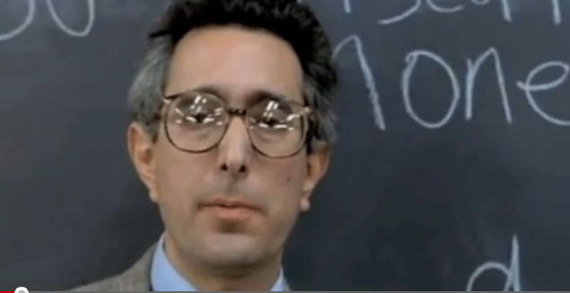
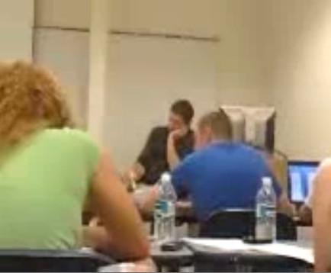
Don’t
do this
More importantly, don’t do this.

Slide 6
Your
turn!
What is
active learning?
Define,
3 terms.

Slide 7
Define active learning:
“
What is
active
learning?
Techniques where students do more than simply listen.
It’s just
good teaching…

Slide 8
Define active learning:
“
1. Learning is active.
2. Learners are different.
Talking,
Writing,
Reading,
Responding,
Reflecting,
Cooperating,
Solving...
Processing,
Discovering,
Applying,
Engaging,
Analyzing,
Synthesizing,
Evaluating,

Slide 9
Cone of Learning (Edgar Dale)
After 2 weeks
We tend to remember…
Nature of Involvement
10% of what we read
Reading
Verbal reception
20% of what we hear
Listening
30% of what we see
PASSIVE
Looking at Pictures
50% of what
we hear and
see
Watching a movie
Visual reception
Looking at an Exhibit
Watching a Demonstration
Seeing it Done on Location
70% of what
we say
Participating in a Discussion
Receiving/
Participating
Giving a Talk
90% of what we say and do
Active
Doing a Dramatic Presentation
Simulating the Real Experience
Doing
Doing the Real Thing
Dale, E. (1969) Audio-Visual Methods in Teaching, 3rd ed. Holt Rinehart and Winston

Slide 10
Your
turn!
What does inactive and active learning look like in online courses?
3 examples of each.

Slide 11
INactive learning online:
Inactive Online
Lots of files to download,
PowerPoint after PowerPoint,
No instructor presence,
No student connections.

Slide 12
Engage!
3 Types of Interaction
Student to Student,
Student to Instructor,
Student to Content.
It’s just
good teaching…

Slide 13
Active learning online:
Individuals
Drop box lectures,
Games,
Reactions to a video,
Mini research proposals or projects,
Analyzing case studies,
Keeping journals or logs.

Slide 14
Active learning online:
Dyads
Think-Pair-Share,
Student generated exam questions,
Write and produce a newsletter.

Slide 15
Active learning online:
Groups
Collaborative learning,
Student-led review,
Student debates,
Problem solving,
Low stakes projects,
Concept mapping.

Slide 16
Your
turn!
What educational technologies can be used for active learning in online courses?
What tech do you use that can be used online?

Slide 17
EdTech
Online
Image, Audio, Video
Picasa for photo stories,
Audacity and Podbean for a podcast series,
YouTube for video introductions,
Jing for screen shots and screen casts.

Slide 18
EdTech
Online
Synchronous Tools
Skype for chat or voice calls,
Elluminate for working with real-life clients.

Slide 19
EdTech
Online
New Media
Twitter for staying on top of topic trends,
Blogger for blogging,
Google Sites for collaborative project development.

Slide 20
EdTech
Online
Presentation Tools
Prezi for dynamic presenting,
Slideshare for sharing presentations,
Voicethread for collaborative commenting.

Slide 21
EdTech
Online
Google Docs
Docs for collaborative note taking,
Presentation for group projects,
Drawing for mindmaps,
Spreadsheet for comparing,
Forms for polls.

Slide 22
Your
turn!
How to make your
online courses
ADA and UDL
compliant.

Slide 23
ADA and
UDL compliance
Case-by-case basis:
physical disabilities, mental. disorders, etc.
What is ADA?
ADA: Americans with Disabilities Act.
2010 Standards for Accessible Design.

Slide 24
Text:
black on white,
sans-serif,
Links:
mind your ‘click here’,
Graphics:
make sure you have alt tags,
Video and audio:
provide closed-captioning,
provide text versions.
Work with your DSS Office
they know their students best.
ADA and
UDL compliance
What is ADA?
ADA: Americans with Disabilities Act.
2010 Standards for Accessible Design.

Slide 25
ADA and
UDL compliance
Flexibility and autonomy
vs.
One-size-fits-all.
What is UDL?
“A set of principles for curriculum development that give all individuals equal opportunities to learn.”

Slide 26
ADA and
UDL compliance
Representation:
show the information in different ways,
Action and Expression:
give student autonomy to choose tasks and demonstrate what they know,
Engagement:
offer options that engage students and keep their interest.
What is UDL?
“A set of principles for curriculum development that give all individuals equal opportunities to learn.”
One-size-fits-all vs. flexibility and autonomy.

Slide 27
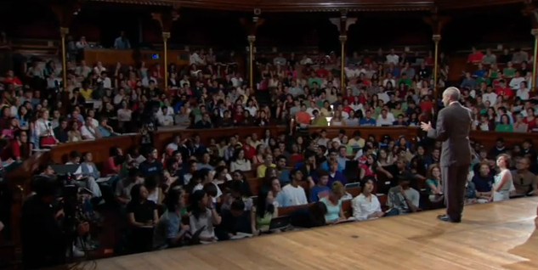
DISCLAIMER
Justice with
Michael Sandel.
Lectures DO have their place.
DO they have limits?

Slide 28
DISCLAIMER
Prepare students first.
There may be some resistance from students.

Slide 29
DISCLAIMER
Solicit feedback.
Expect successes and failures.

Slide 30
Questions?
Leah MacVie
Instructional Designer at Canisius College
Blogger, Photographer, Educationist
www.leahmacvie.com
@leahmacvie
in/leahmacvie
leah.macvie

